Slide 1
X² significance test
2 main situations
Goodness-of-fit test: want to test how well a set of observed data fit a particular distribution
Test for independence: use a contingency table to investigate whether 2 factors are independent or whether there is an association between them

Slide 2
Characteristics of the distribution
No of degrees of freedom=no of classes – no of restrictions
It is reversed J-shaped for v=1 and 2
It is positively skewed for v ˃2
The larger the value of v, the more symmetric the distribution becomes
When v is large, the distribution is approximately normal

Slide 3
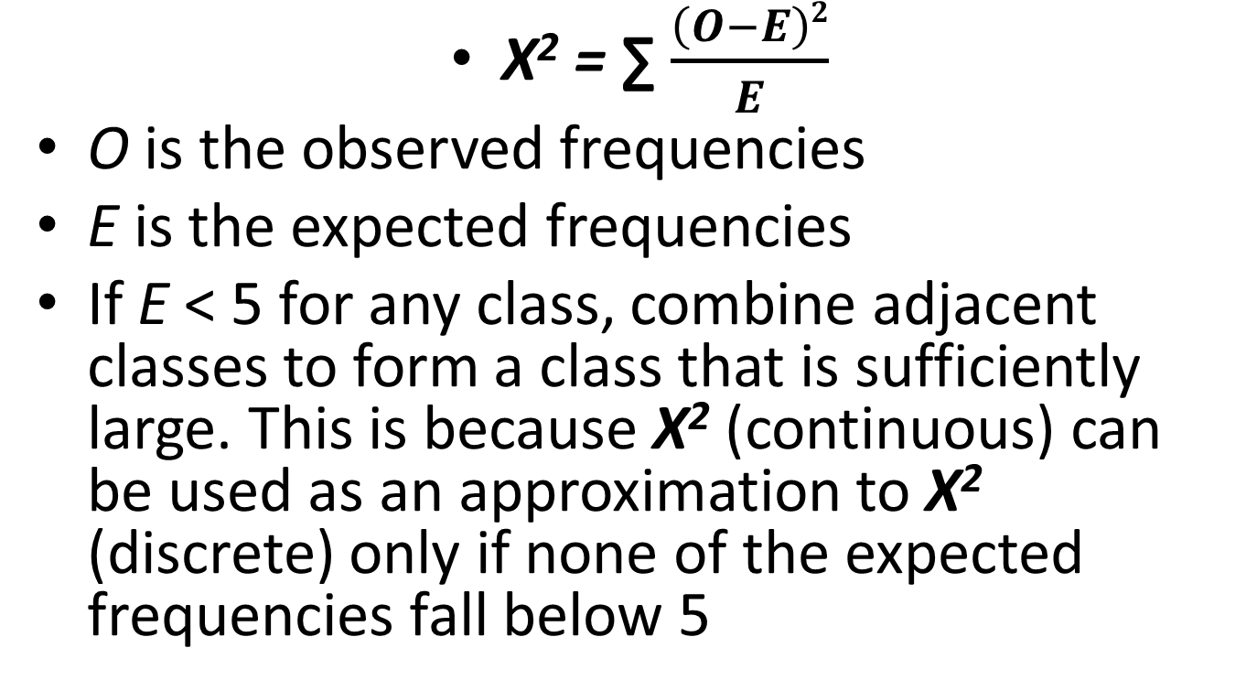
The test statistics
X² = ∑ $\frac{\left(O−E\right)2}{E}$
O is the observed frequencies
E is the expected frequencies
If E ˂ 5 for any class, combine adjacent classes to form a class that is sufficiently large. This is because X² (continuous) can be used as an approximation to X² (discrete) only if none of the expected frequencies fall below 5

Slide 4
X² test compares each observed frequency with the corresponding expected frequency
If X² = 0, then there is exact agreement between the observed and expected frequencies
If X² ˃ 0, then O and E do not agree exactly; the larger the value of X² the greater the discrepancy and it implies a poor fit
This is why the X² test is conducted as a one-tailed (upper tail) test

Slide 5
Test 1- Goodness-of-fit for uniform distribution
Example 12.1
H_{o} : the distribution fits a uniform distribution ie. the no of absentees is the same everyday
H₁ : the distribution does not fit

Slide 6
Test 2- Goodness-of-fit for a distribution in a given ratio
Example 12.2
H_{o} : the colour are in the ratio 3:2:5
H₁ : the colours are not in the ratio 3:2:5

Slide 7
Test 3- Goodness-of-fit test for a binomial distribution
Example 12.3
Let X be the number of heifer calves born to a cow in the first five years of breeding
H_{o} : X ~ B (5,0.5)
H₁ : X is not distributed in this way
Part(b) p is estimated from the data, so v = 5-2

Slide 8
Test 4 – Goodness-of-fit for a poisson distribution
Example 12.4
Let X be the number of goals scored in a match
H_{o} : X ~ Po(2)
H₁ : X is not distributed this way

Slide 9
Test 5-Goodness-of-fit test for a normal distribution
Example 12.6
H_{o} : X ~ N(50,15²)
H₁ : X is not distributed this way
Example 12.7
The mean and variance is estimated from the data, so v = 6-3

Slide 10
Test 6- Goodness of fit of a Geometric Distribution
Refer to handout given
Y ~ the length of a run
H_{o} : Y ~ Geo(1/2)
H₁ : Y is not distributed this way

